Slide 1

Web Service and Database Handling part 1 : SELECT
Emerging Technology : Flutter
Week 8
Program Studi Teknik Informatika
Fakultas Teknik – Universitas Surabaya

Slide 2
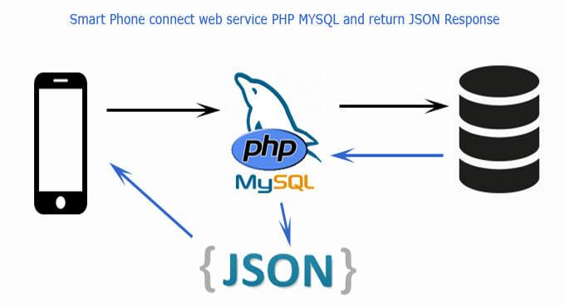
Frontend + Webservice

Slide 3

ONLINING API
01

Slide 4

Onlining API
In this chapter and for next several chapters, we will use a webservice.
We can use our computer/laptop as web service provider (localhost), but we will encounter some difficulties.
If we use emulator, we have to change the IP by 10.0.2.2.
When we use a device, we have to connect device and our computer in the same network (for example in the same wifi access) and we have to know the computer IP and change the address to that IP.
A way to make it more comfortable, is by put the web service on the internet. If the web service address is an internet address, we do not need to change our source code while running it in device or in emulator.

Slide 5
Yippii Free Hosting..!
We provide a free hosting for native class and project. Each student have his/her own space and internet address to put API and mysql database to put the application data.
Each student have a space in ubaya.cloud domain. Source code can be uploaded using SCP/SSH application for example winscp or filezilla with host 103.16.116.155 port 22 and username = flutter_[NRP], ex= flutter_160921011 password = ubaya
Your physical directory is : /var/www/html/flutter/[NRP]
ex: /var/www/html/flutter/160921011 . If you create, for example, products.php in this directory, you can access it in browser with : https://ubaya.cloud/flutter/[NRP]/products.php
ex: https://ubaya.cloud/flutter/160921011/products.php.
For the Database, every student have 1 database with name flutter_[NRP], ex flutter_160921011, user can not create any new database, just can create tables inside the provided one.
For manage the database you can access: https://ubaya.cloud/phpmyadmin username = flutter_[NRP] , ex= flutter_160921011 password = ubaya. Therefore when your php want to connect to your database, it should use this syntax
$con = new mysqli("localhost", ”flutter_160921011","ubaya",”flutter_160921011");

Slide 6
JSON
02

Slide 7
What is JSON
JSON stands for JavaScript Object Notation
JSON is a lightweight format for storing and transporting data
JSON is often used when data is sent from a server to a web page or app
JSON is "self-describing" and easy to understand
JSON array
JSON data
"employees":[
{"firstName":"John", "lastName":"Doe"},
{"firstName":"Anna", "lastName":"Smith"},
{"firstName":"Peter", "lastName":"Jones"}
]
JSON Object

Slide 8
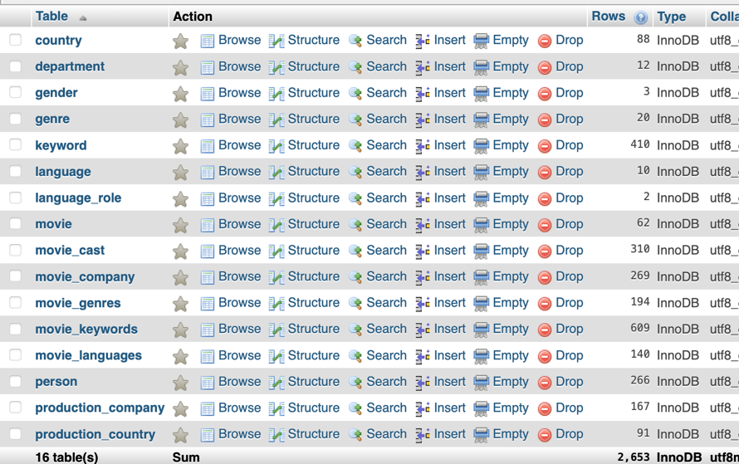
Data Preparation
Restore data movie.sql (download from ULS)

Slide 9
PHP
<?php
header("Access-Control-Allow-Origin: *");
$arr=null;
$conn = new mysqli("localhost", "[yourlogin]","[yourpassword]","[yourdatabase]");
if($conn->connect_error) {
$arr= ["result"=>"error","message"=>"unable to connect"];
}
$sql = "SELECT * FROM movie ";
$stmt = $conn->prepare($sql);
$stmt->execute();
$result = $stmt->get_result();
$data=[];
if ($result->num_rows > 0) {
while($r=mysqli_fetch_assoc($result))
{
array_push($data,$r);
}
$arr=["result"=>"success","data"=>$data];
} else {
$arr= ["result"=>"error","message"=>"sql error: $sql"];
}
echo json_encode($arr);
$stmt->close();
$conn->close();
?>
Write php code that read movie table and shows the content in JSON format.
we name it movielist.php

Slide 10
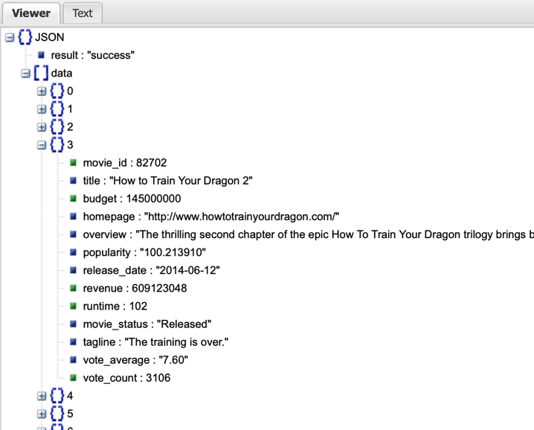
Check result
Check your php in browser.
You can see JSON in better appearance in JSON Viewer application such as
http://jsonviewer.stack.hu

Slide 11
READ WEB SERVICE
03

Slide 12
Preparation
JSON Movie data from previous will be displayed in a new page. Prepare this page with name PopularMovie page.
import 'package:flutter/material.dart';
class PopularMovie extends StatefulWidget {
const PopularMovie({super.key});
@override
State<StatefulWidget> createState() {
return _PopularMovieState();
}
}
class _PopularMovieState extends State<PopularMovie> {
@override
Widget build(BuildContext context) {
return Scaffold(
appBar: AppBar(
title: const Text('Popular Movie') ),
body: ListView(children: <Widget>[]));
}
}

Slide 13
http package
Fetching data from the internet is necessary for most apps. Luckily, Dart and Flutter provide tools, such as the http package, for this type of work.
This recipe uses the following steps:
- Add the http package.
- Make a network request using the http package.
- Convert the response into a custom Dart object.
- Fetch and display the data with Flutter.
in pubspec.yaml :
http: ^1.5.0
in page:
import 'package:http/http.dart' as http;
in android/app/src/main/AndroidManifest.xml
<uses-permission android:name="android.permission.INTERNET" />

Slide 14
Fetching data
For simplifying, first, JSON data will be read as String and just show it in the page.
String _temp = 'waiting API respond…';
Future<String> fetchData() async {
final response = await http
.get(Uri.parse("https://ubaya.cloud/flutter/[nrp]/movielist.php"));
if (response.statusCode == 200) {
return response.body;
} else {
throw Exception('Failed to read API');
}
}
Show at a Text

Slide 15
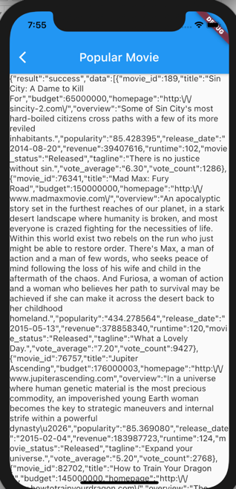
Call fetchdata and do setState
Call fetchData function and if the response came,
Do setState and update the String variable.
bacaData() {
Future<String> data = fetchData();
data.then((value) {
setState(() {
_temp = value;
});
});
}
@override
void initState() {
super.initState();
bacaData();
}

Slide 16
CONVERTING JSON
04

Slide 17
Convert JSON
In order to make JSON data easier to handle, it is suggested to convert it into array of object.
Create a file that define the class. ex: /class/popmovie.dart
class PopMovie {
int id;
String title;
String overview;
String voteAverage;
PopMovie({required this.id, required this.title, required this.overview, required this.voteAverage });
factory PopMovie.fromJson(Map<String, dynamic> json) {
return PopMovie(
id: json['movie_id'] as int,
title: json['title'] as String,
overview: json['overview'] as String,
voteAverage: json['voteAverage'] != null ? json['voteAverage'].toString() : '0.0',
);
}
}
Also prepare the array:
List<PopMovie> PMs = [];

Slide 18
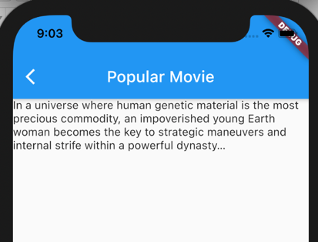
Modify bacadata
bacaData() {
Future<String> data = fetchData();
data.then((value) {
Map json = jsonDecode(value);
for (var mov in json['data']) {
PopMovie pm = PopMovie.fromJson(mov);
PMs.add(pm);
}
setState(() {
_temp = PMs[2].overview;
});
});
}
this proves that we already got the movie records, and can pick the field value

Slide 19
Create Widget Builder
Array of object can be used in widgets which have builder on it such as ListBuilder.
For start, we just put a simple text first.
Widget DaftarPopMovie(PopMovs) {
if (PopMovs != null) {
return ListView.builder(
itemCount: PopMovs.length,
itemBuilder: (BuildContext ctxt, int index) {
return Text(PopMovs[index].title.toString());
});
} else {
return const CircularProgressIndicator();
}
}
Can also be replaced with loading gif

Slide 20
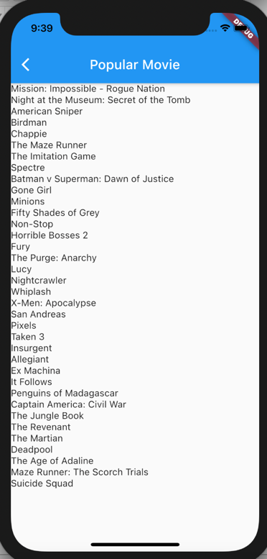
Calling the Widget
return Scaffold(
appBar: AppBar(
title: const Text('Popular Movie'),
),
body: ListView(children: <Widget>[
Container(
    height: MediaQuery.of(context).size.height-200,
    child: DaftarPopMovie(PMs),
    )
]));

Slide 21
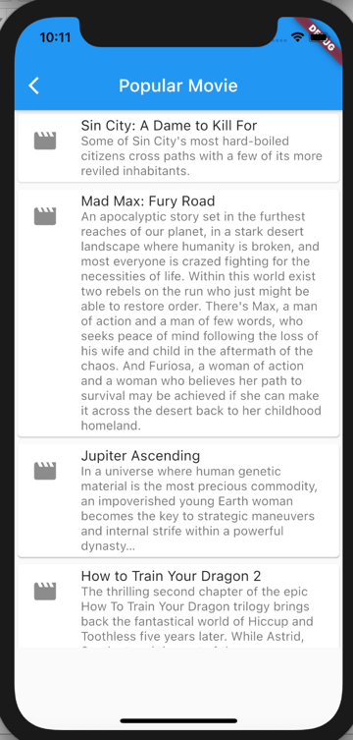
Modifying widget
After running well, we can modify the appearance of the widget. For example, with a card.
return Card(
child: Column(
mainAxisSize: MainAxisSize.min,
children: <Widget>[
ListTile(
leading: const Icon(Icons.movie, size: 30),
title: Text(PopMovs[index].title),
subtitle: Text(PopMovs[index].overview),
),
],
));
Can you add url field in movie table ,fill in image url of the movie poster (for now, just 2 or 3 movies), and then change the icons.movie with this url image when the url is not empty?

Slide 22
EXERCISE
05

Slide 23
Exercise
  Using the same way in previous chapters, Create new screen ( called PopularActor) for showing Actor-Actress name from person table.

Slide 24
More Reading
When your project is getting larger, it’s a good idea not to manually decode JSONs to our classes
Even a slight typo on JSON field name may cause hard-to-track bugs
For bigger projects, use code generations
Read more here: https://docs.flutter.dev/development/data-and-backend/json#use-code-generation-for-medium-to-large-projects

Slide 25



